Slide 1
Language Learning Techniques
Drake Lundström
RYE 6690 Co-outbound chair
2014 Rotary Exchange Student of the year, Brazil 4310

Slide 2

Who am I?
Past Exchange students to Ecuador & Brazil
Participant or volunteer at Youth Exchange preparation weekends since 2010
Quadrilingual, and working on my fifth (English, Portuguese, Japanese, Spanish, and learning Swedish)

Slide 3
Overview
The importance of learning language before exchange
How people learn language
What has our district done
Next steps to keep improving
Open discussion

Slide 4

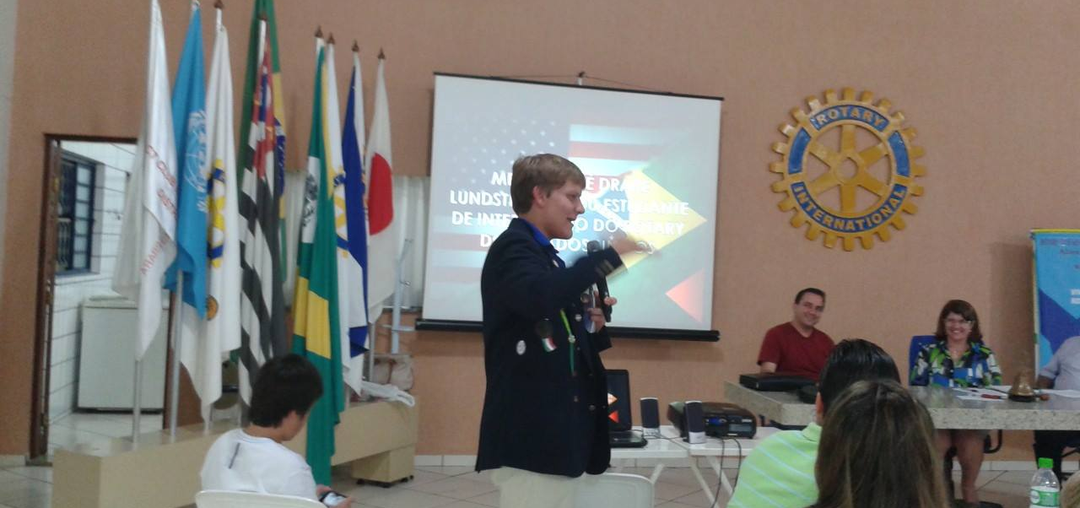
Why Study Language Before Exchange
Provides a framework to learn faster while overseas
Creates a better first impression
Lets students connect more with classmates, families, and Rotarians
Makes them a better exchange student

Slide 5
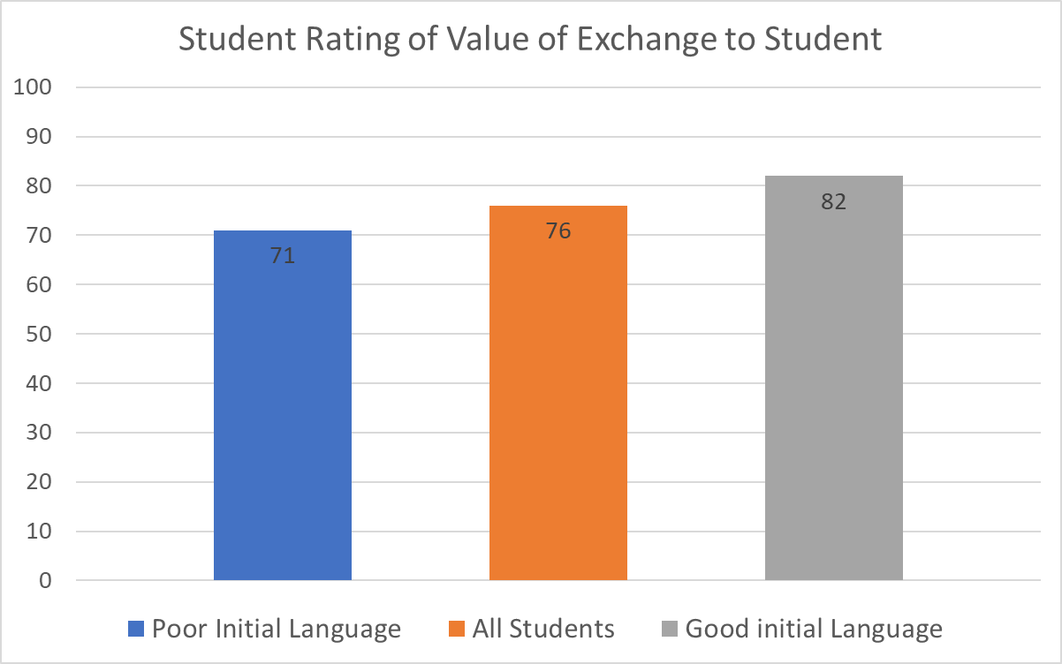
Results of Post Exchange Survey by Language self Assessment

Slide 6
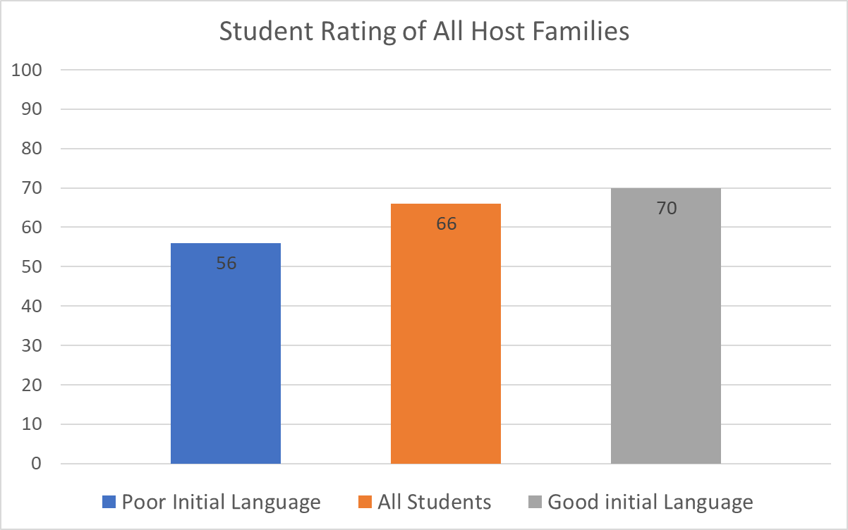
Results of Post Exchange Survey by Language self Assessment

Slide 7
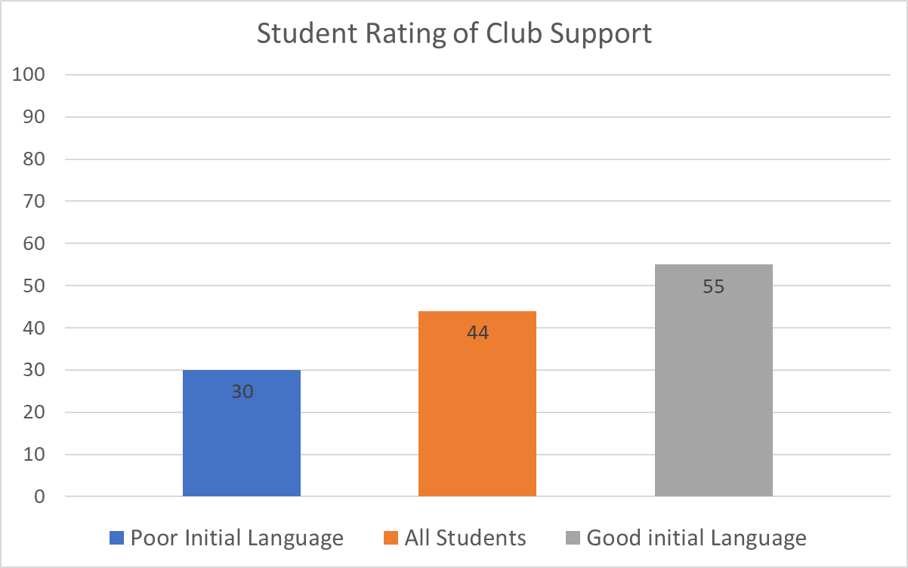
Results of Post Exchange Survey by Language self Assessment

Slide 8
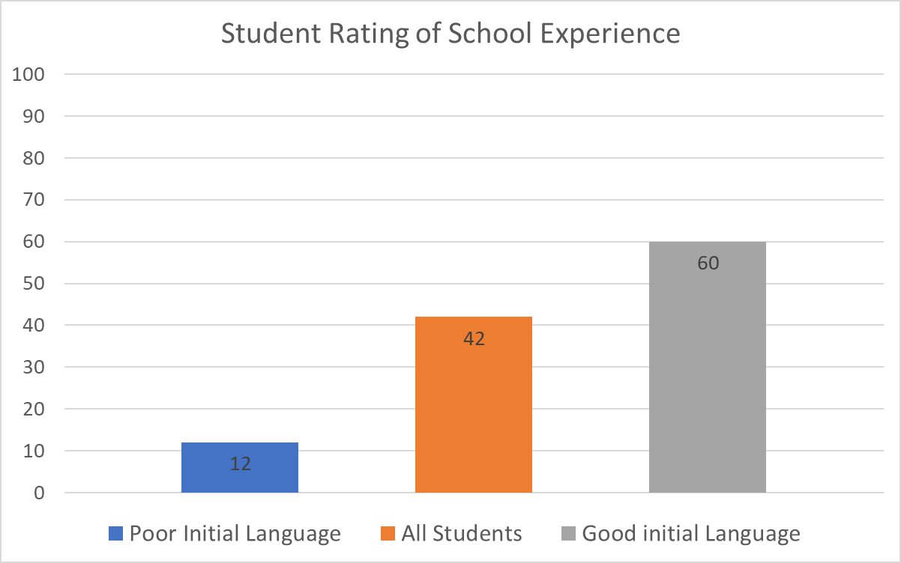
Results of Post Exchange Survey by Language self Assessment

Slide 9

How people learn language
Adults immersed in a language learn faster and better than children
Language learning is most effective when you learn it how you will use it
Everything you need to learn almost any language is now online for free or almost free
The largest difficulty for learning a language is motivation and willpower

Slide 10

How people learn language
Set short term action items rather than vague future goals:
  I will do 2 Pimsleur lessons a day
  I will work with my tutor for an hour each week
  Ect.
Cramming in the last minute is less effective for long term retention
Ways to help students:
  Check in in early if students are falling behind
  Test students and make them demonstrate their ability, for you and for themselves

Slide 11
How not to learn language
Just wait and plan to learn it overseas
Cram in lessons in the last minute
Try to read grammar textbooks
Assume that everyone learns the same way and force a student down a certain path
Download 100 different free Spanish apps and never really use any of them
Do it alone, without a support network

Slide 12
6690 Current Language Preparation Last Year
Pimsleur lessons, at a rate of 2 per week
Pimsleur is considered the bare minimum, other language training is advised, especially meeting with a tutor
Pimsleur progress is checked monthly, with specific lesson goals each month.
Other support emails are sent on around a biweekly basis, asing if support is needed
Students practice and must demonstrate language at training weekends

Slide 13
6690 Current Language Results

Slide 14
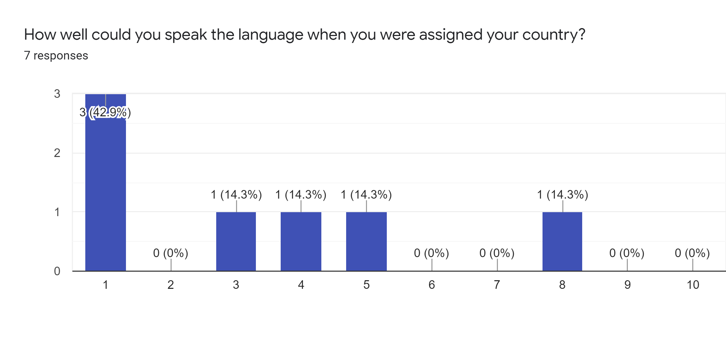
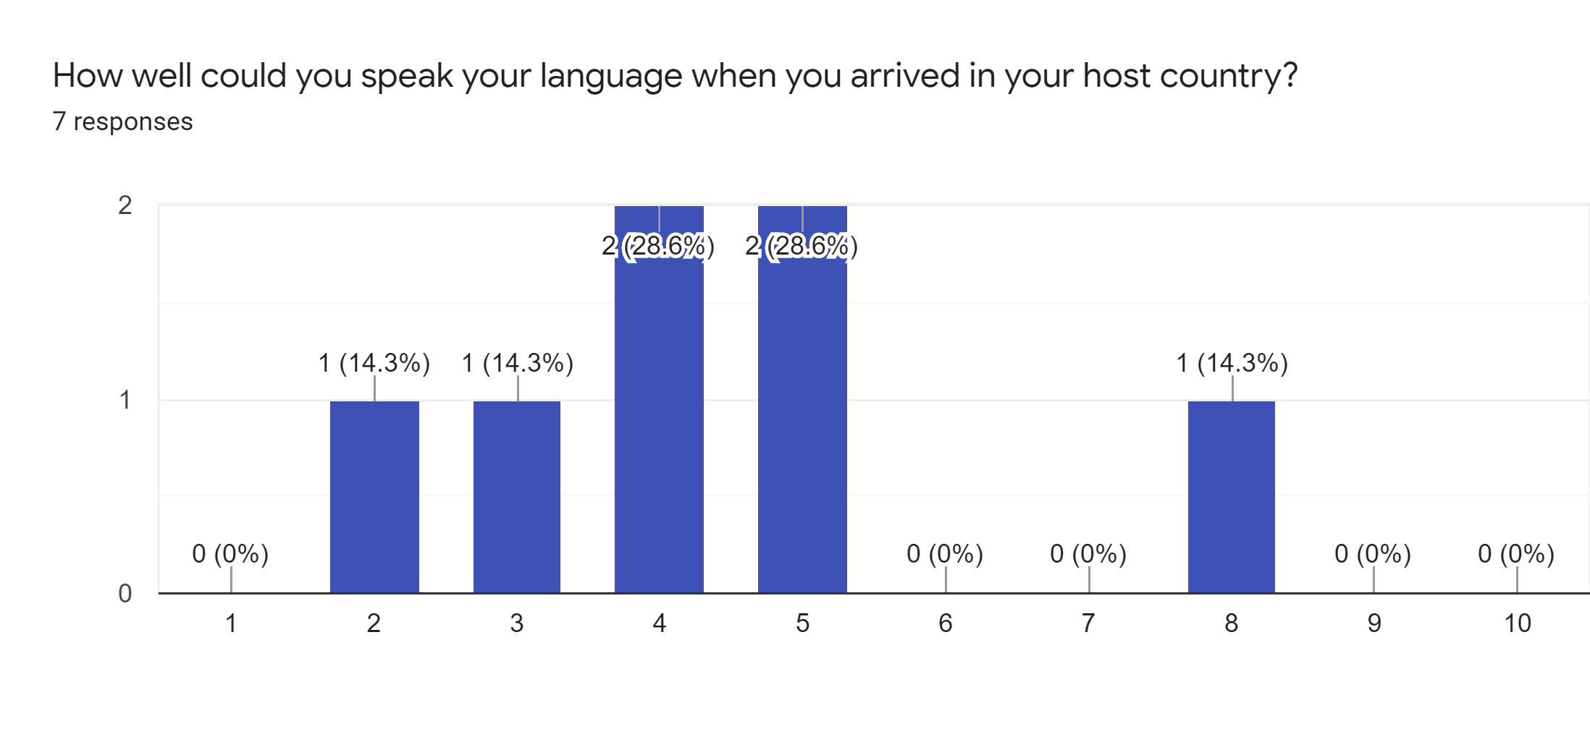
6690 Current Language Results

Slide 15
6690 Current Language Results

Slide 16
6690 Current Language Results

Slide 17
6690 Current Language Results

Slide 18
6690 Current Language Results

Slide 19
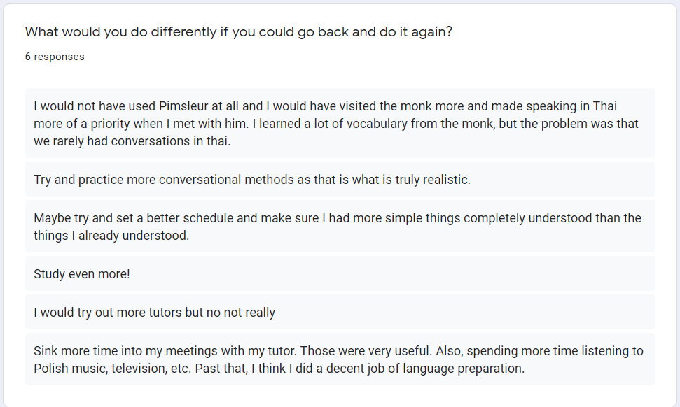
6690 Current Language Results

Slide 20
6690 Current Language Results
Students who later dropped out of the program stopped doing pimsleur early on.
Students showed an increase in language skill before arriving in host country
Students have outperformed other exchange students in terms of language
The students are not fans of Pimsleur
  Pimsleur doesn’t work well for tonal languages like Thai
The students value their language skills

Slide 21
6690 Current Language Results
Pimsleur Hypothesis:
Pimsleur let us track students’ progress, and holding them accountable added the benefits
Pimsleur scared students into studying harder, by showing them how hard languages are
Pimsleur offered very little benefit, and tutors had a much larger impact
Pimsleur works but seemed lacking compared to the tutors, or because it is not fun
Any program works as long as students spend time on it

Slide 22

Why recommend tutors?
Tutors teach a customized lesson, which tends to have better, faster results and be more enjoyable
It is a scheduled and paid for lesson, that will not be skipped like self study sometimes is
Tutors help students learn cultural communication, such as when to use formal language or how to act with parents, teachers, and Rotarians
Tutors are easier to find than ever. If students cannot find one in person, here are a few online tutoring services:
https://www.italki.com/home (most affordable)
https://www.verbling.com
https://preply.com/
https://www.verbalplanet.com/
https://www.tandem.net/tandem-tutors/
https://www.tutor.com/subjects/foreign-languages
https://www.varsitytutors.com/online-tutoring

Slide 23

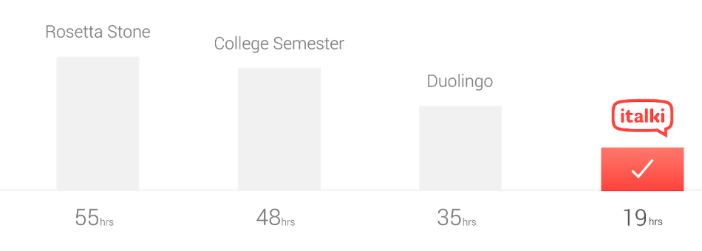
Next steps to keep improving
Move to tutoring only?
Better evaluate language at weekends
Encourage tutors in host country
Convince students to not speak English
Make italki mandatory for minimum requirement?
Use italki for inbound students, to evaluate English level and assign necessary tutoring
Teach students more about retention/tutoring jobs
Videos to show students why not to speak English:
https://www.youtube.com/watch?v=G1RRbupCxi0
https://www.youtube.com/watch?v=Fpa0USCqJGY&list=PL7oosQ7uWqRP120DOAfngdXAthvWsAhd8

Slide 24
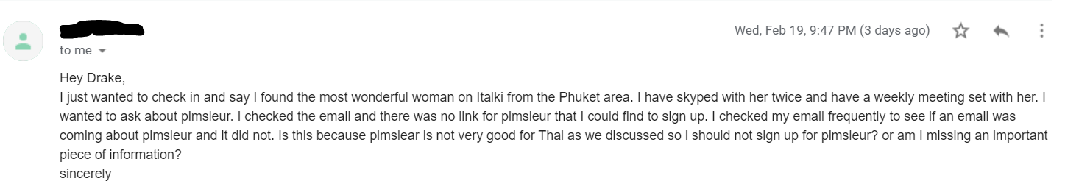
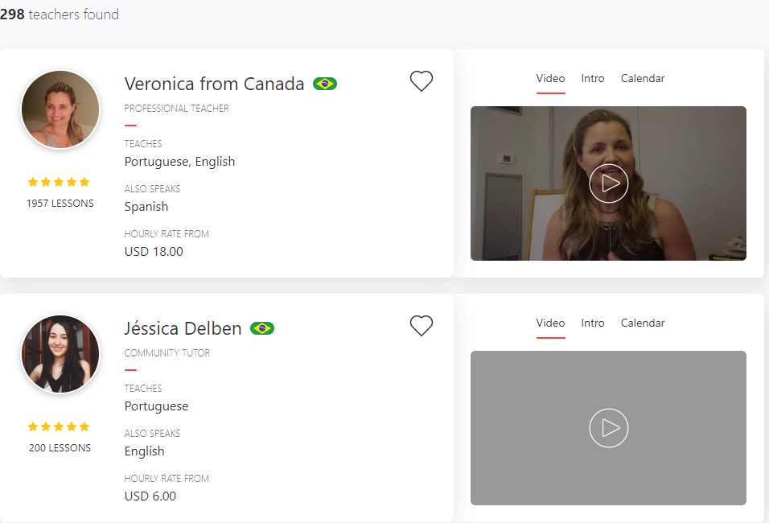

What is Italki?
Online language tutoring platform for 1 on 1 lesson
Classes range from $4-$40 an hour, with most lessons being around $10. The cheaper teachers are just as good
Contains more languages than pimsleur, can be done from computer or phone
Can be set up to track student lessons, and send students credits to spend

Slide 25
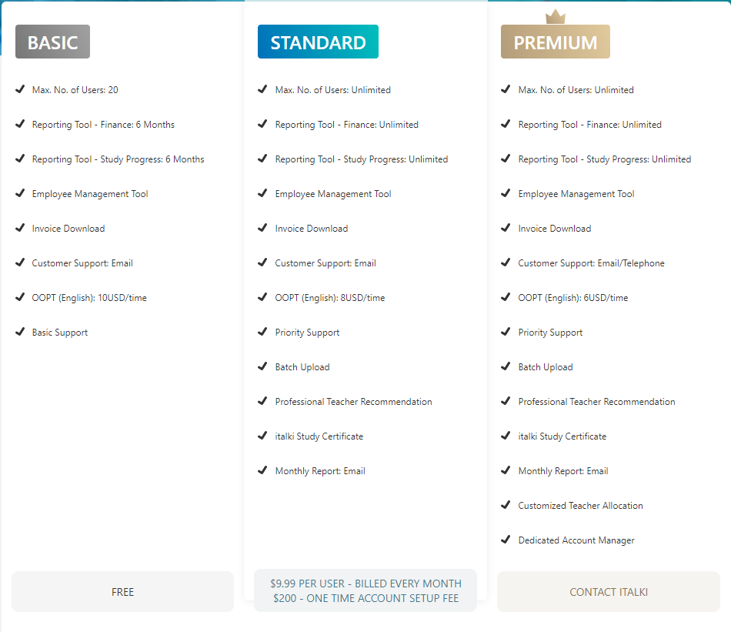

Slide 26
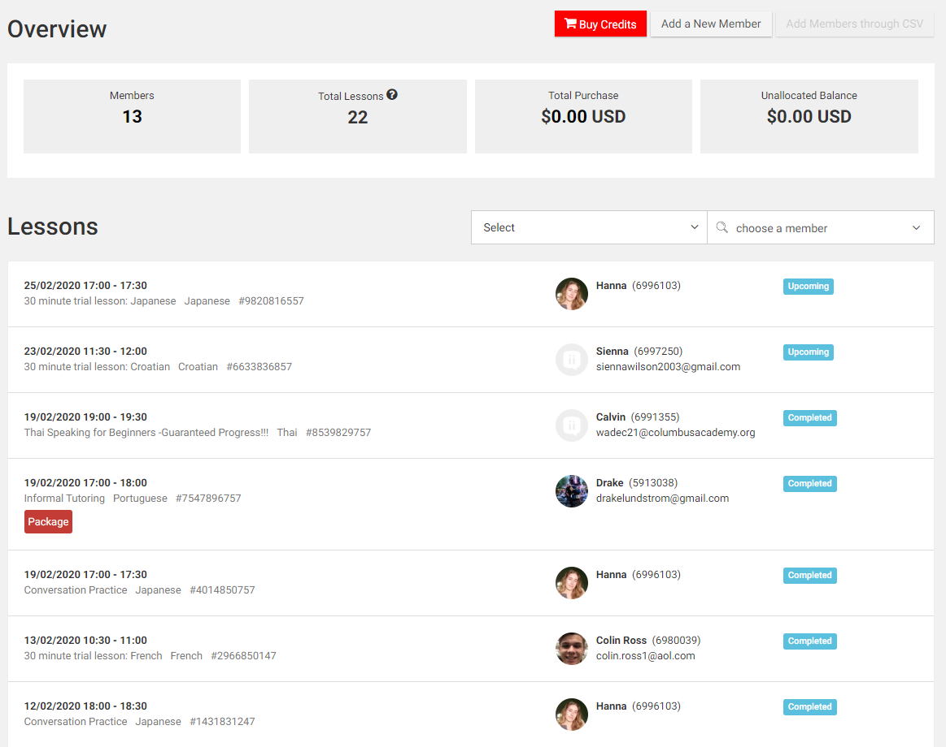

Slide 27
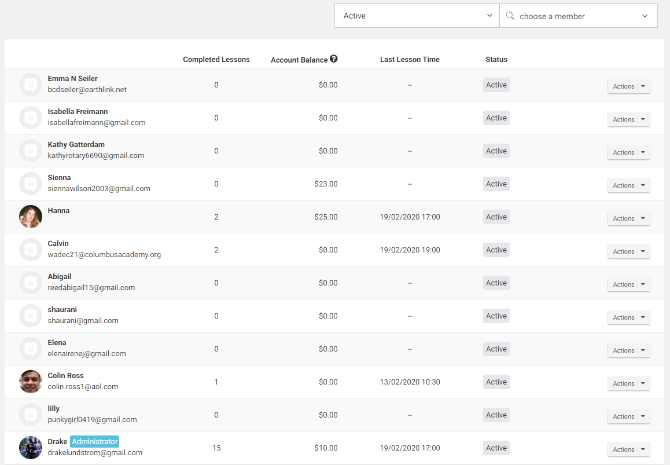

Slide 28
How has your language level affected your exchange: the Positives
“It has saved my exchange effectively. I am the most isolated exchange student in Poland. No exchange student lives within 40km of me. Being able to speak even a smattering of Polish has made it viable for me to ask people to hang out and have fun, especially in leu of having no other exchange students. My host parents speak no English either. My ability to speak decent Polish is my lifeline here.”
“Made it immensely easier to make local friends, connect with my host family, impress Rotarians, and overall the key to success with my exchange.”
“Speaking French has really helped me, especially at school because I was able to make friends a lot faster and therefore become integrated into my class and school. And so instead of doing nothing all day at school, I can participate and talk with my teachers and friends.”

Slide 29
How has your language level
affected your exchange: the Negatives
“It made it the process of connecting with Thai people (for example my host family and classmates) take a bit longer. Now I am able to speak a bit of Thai with them and they enjoy teaching me new words and phrases.”
“It is hard to say, as Castellano Spanish is not necessarily the language spoken here and they mix a few languages in their speech. So sometimes I really get frustrated but I am being patient and trying to not let it ruin my time here.”

Slide 30

Pimsleur random difficulties
After payment, it takes 4-6 weeks to get the course
There are problems sending vouchers to students
There are some weird issues with the language tracking
I have a separate, tutorial, step by step powerpoint for the voucher and tracking issues, please contact me and I will send it to you

Slide 31


Slide 32
Summary of main points:
Language level has a large impact on exchange
The most important part of language learning is consistency/accountability
Holding students to Pimsleur target improves language level of outbound students
Tutors offer many benefits and cultural learning
Online tutoring services like italki may be a good, afforadable option for holding students accountable

Slide 33




Language Learning Techniques
Thank you

Slide 34
Questions?
Drake Lundstrom
RYE 6690 Outbound chair
DrakeLundstrom@gmail.com
614-260-7324

